Slide 1

TOPIC 4
Fundamental of Project Management (Part 3)
Planning and Scheduling

Slide 2
PROJECT SCHEDULING

Slide 3
01
Gantt Chart
02
How to convert from Gantt Chart to Pert Charts
03
Pert Chart
04
Activity Networks and Critical Path Method

Slide 4
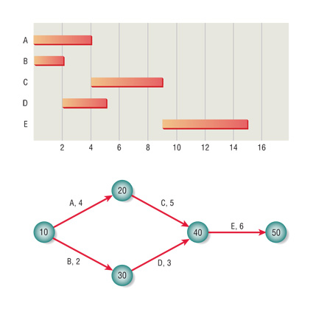
Project Scheduling Techniques
Gantt Charts
PERT diagrams
Critical Path Method

Slide 5
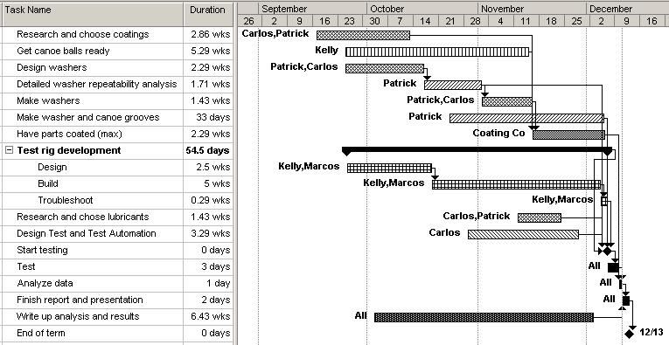
Project Scheduling Techniques #1:
Gantt Charts
Chart in which bars represent tasks or activities
Advantages:
  Simple : easy to understand
  Worthwhile communication with end user.
  Drawn to scale : sequence of activities/tasks with length durations
* Assign more than 1 roles to specific task names

Slide 6
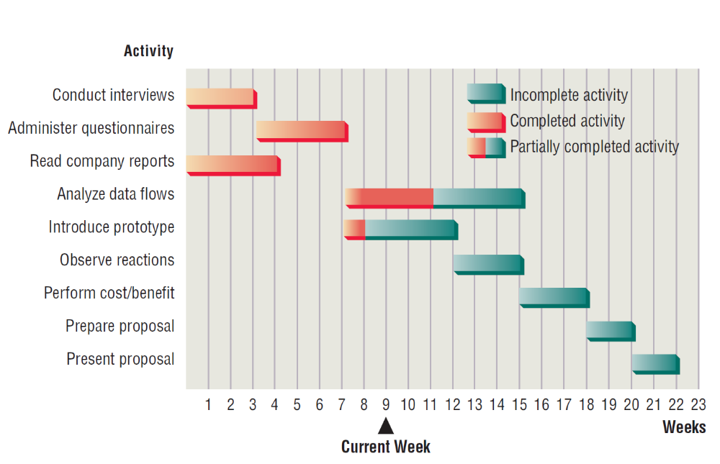
Gantt Chart (2 Dimensions)
* Using a two-dimensional Gantt chart for planning activities that can be accomplished in parallel

Slide 7
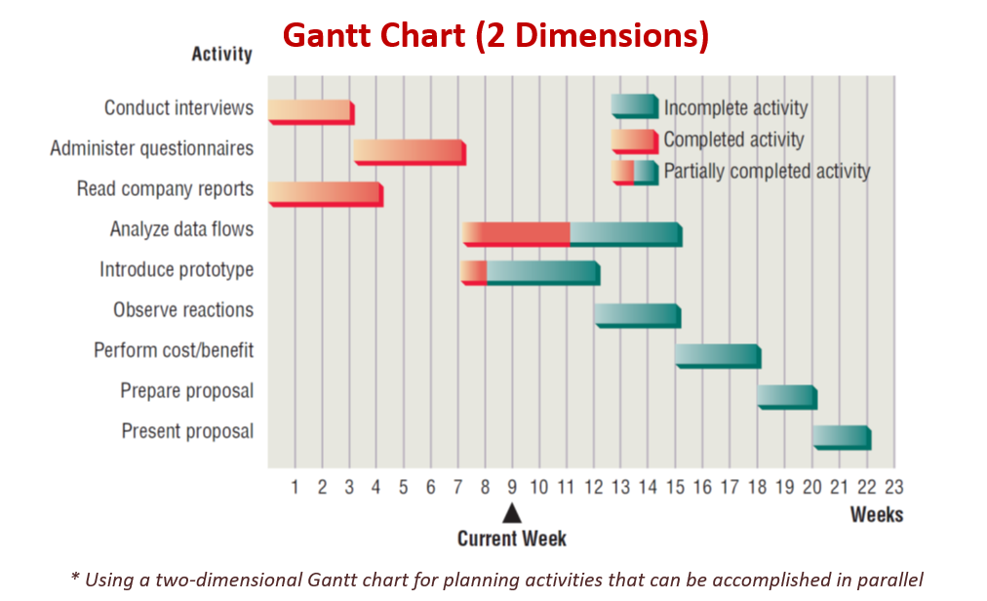
How to convert from gantt to pert chart
Step 1: List All Activities
Step 2: Identify start and end dates for duration
Step 3: Determine Dependencies
Step 4: Create Pert Chart
  Use nodes (circles) to represent events
  Use arrows to represent activities (Activity, Duration)
  (A,3)
Step 5: Identify Merging Paths and Logic
Step 6: Analyze for Critical Path

Slide 8
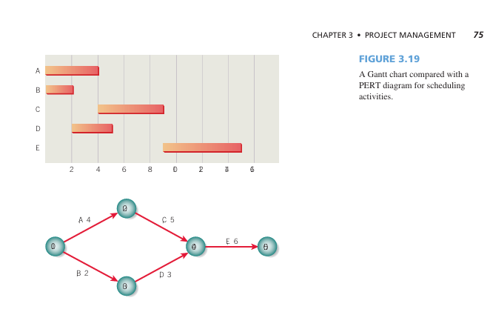
Gantt chart to Pert Chart
In the PERT example shown here, activity C may not be started until activity A is completed.
Precedence is not indicated at all in the Gantt chart, so it is not possible to tell whether activity C is scheduled to start on day 4
on purpose or by coincidence.
A project has a beginning, a middle, and an end; in this example, the beginning is event 10, and the end is event 50.
To find the length of the project, each path from beginning to end is identified, and the length of each path is calculated.
In this example, path 10–20–40–50 has a length of 15 days, whereas path 10–30–40–50 has a length of 11 days.
Even though one person may be working on path 10–20–40–50 and another on path 10–30–40–50, the project is not a race.
The project requires that both sets of activities (or paths) be completed; consequently, the project takes 15 days to complete.
Activity | Predecessor(s) | Duration (Days) | Start Time | End Time
A | — | 4 | 0 | 4
B | — | 2 | 0 | 2
C | A | 5 | 4 | 9
D | B | 3 | 2 | 5
E | C, D | 6 | 9 | 15
20
10
40
50
10
30
The longest path (A → C → E) = Critical Path, total duration = 15 days.

Slide 9
Project Scheduling Techniques #2:
PERT diagram
Advantages:
  Easy identification of the order of precedence.
  Easy identification of the critical path and thus critical activities.
  Easy determination of slack time.
Occasionally, PERT Diagram need pseudo-activities, referred to as dummy activities
It is used to preserve the logic or clarify the diagram.

Slide 10
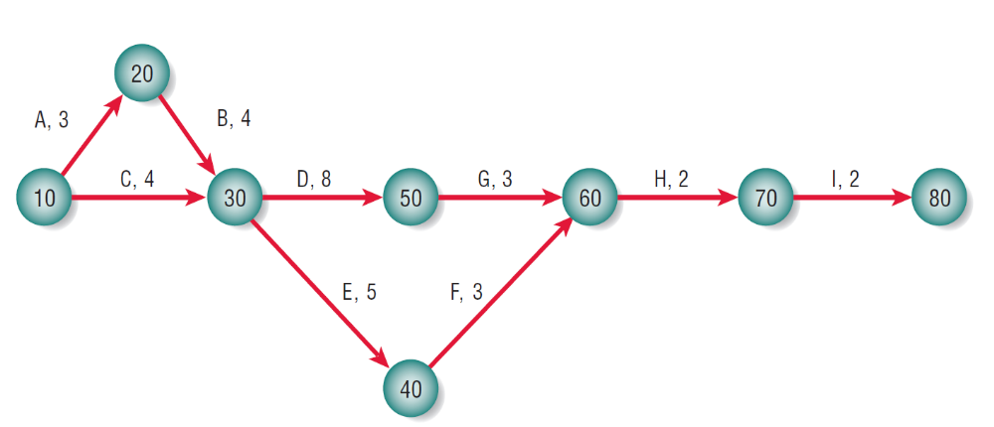
Project Scheduling Techniques #2:
PERT diagram
  Program Evaluation and Review Technique (PERT)
    Program = project
Useful when activities can be done in parallel rather than sequence.
  sometimes known as Network diagram
    Represented by a network of nodes and arrows - - nodes denote events & arrows denote activities
  Nodes
    called event, identified by numbers, letters etc
    To recognize that an activity is completed
    Indicate which activities need to be completed before new activities maybe undertaken (precedence)
A,3 - means Activity A has a duration of 3 days/weeks/months

Slide 11
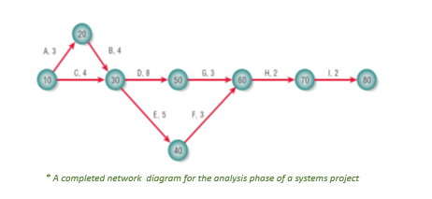
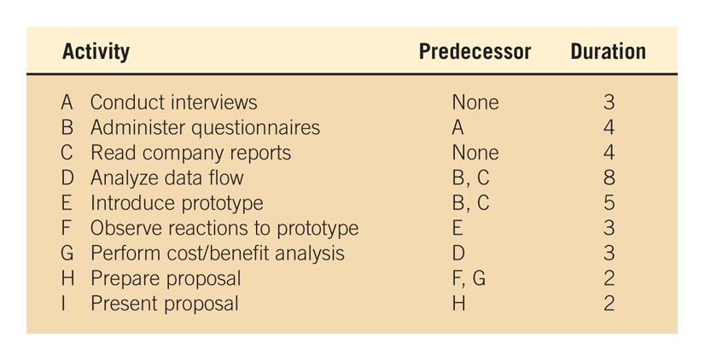
Example: How to develop PERT diagram for the following activities in Analysis Phase?

Slide 12

Example of developed PERT diagram
* A completed network diagram for the analysis phase of a systems project

Slide 13

Project Scheduling Techniques #2:
PERT diagram – dummy activities
Occasionally, PERT Diagram need pseudo-activities, referred to as dummy activities
It is used to preserve the logic or clarify the diagram.

Slide 14
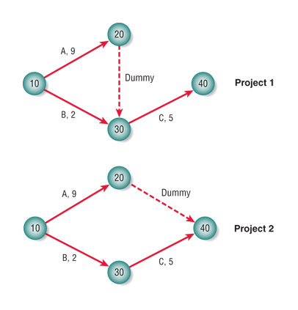
Project Scheduling Techniques #2:
PERT diagram example – inserting dummy
* C can only be started if both A and B are finished
* C only requires B’s completion & could be under way while A is still taking place.
* Insert dummy to show logical sequence of the activity.

Slide 15
Project Scheduling Techniques #3: CRITICAL PATH METHOD (CPM)
CPM is a project network analysis technique used to predict total project duration.
The critical path is the longest path through the network diagram and has the least amount of slack or float.
A critical path for a project is the series of activities that determines the earliest time by which the project can be completed.

Slide 16
FINDING THE CRITICAL PATH
First develop a good project PERT diagram.
Add the durations for all activities on each path through the project network diagram.
The longest path is the critical path.
Note: If one or more activities on the critical path takes longer than planned, the whole project schedule will slip unless corrective action is taken.
  There can be more than one critical path if the lengths of two or more paths are the same.
  The critical path can change as the project progresses.

Slide 17
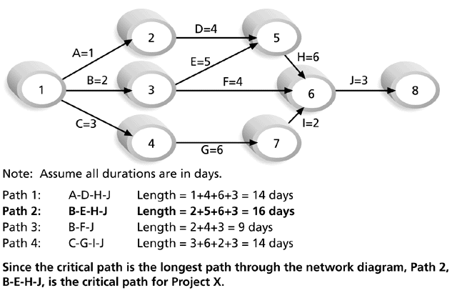
Determining the Critical Path for Project X:

Slide 18
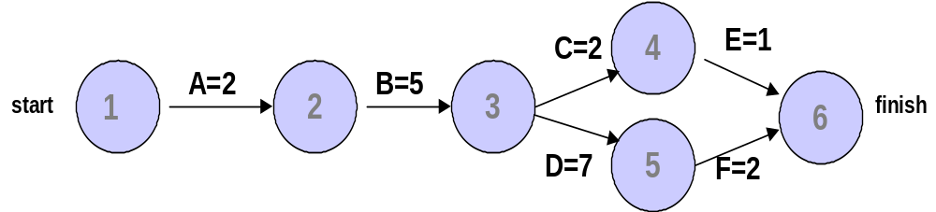
Consider the following project network diagram. Assume all times are in days: a) How many paths are on this network diagram? b) How long is each path? c) Which is the critical path? d) What is the shortest amount of time needed to complete this project?
CPM Example

Slide 19
How to schedule your own project?

Slide 20
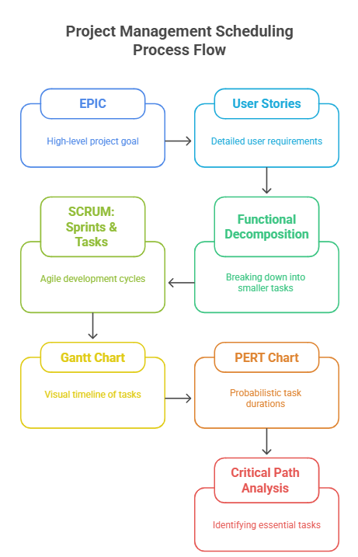

Slide 21
Epic and User Stories
For completing projects on time, within budget and including the features promised, a project needs to be broken down into smaller tasks or activities – work breakdown structure (WBS)
WBS can be product-oriented or process-oriented
Time is estimated for each task or activity.
PHASES
TASK/ACTIVITIES
STEPS
smaller units

Slide 22
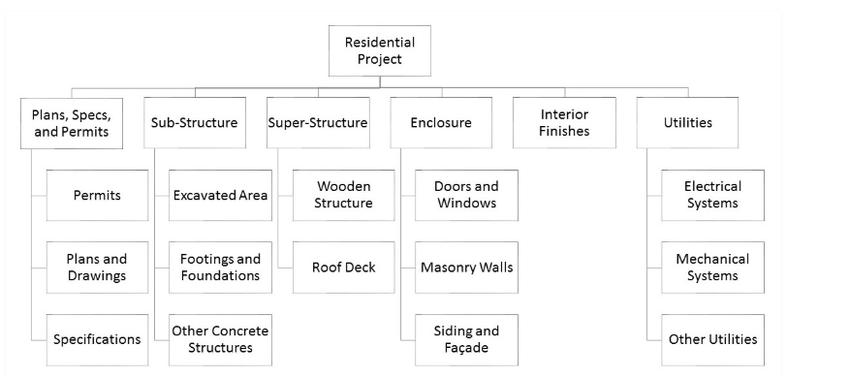
PRODUCT-ORIENTED WBS
https://www.adroitprojectconsultants.com/tag/process-oriented-wbs/

Slide 23
Planning Steps
1
Project is broken down into phases.
Further project is broken down into tasks or activities.
Finally project is broken down into steps or even smaller units.
Time is estimated for each task or activity.
Most likely, pessimistic, and optimistic estimates for time may be used.
2
3
4
5

Slide 24
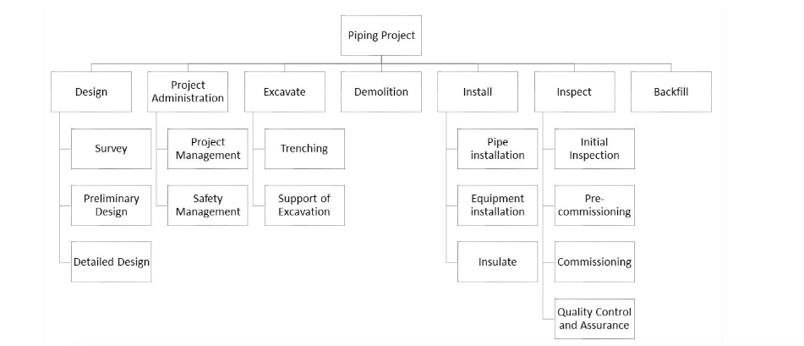
PROCESS-ORIENTED WBS
https://www.adroitprojectconsultants.com/tag/process-oriented-wbs/

Slide 25
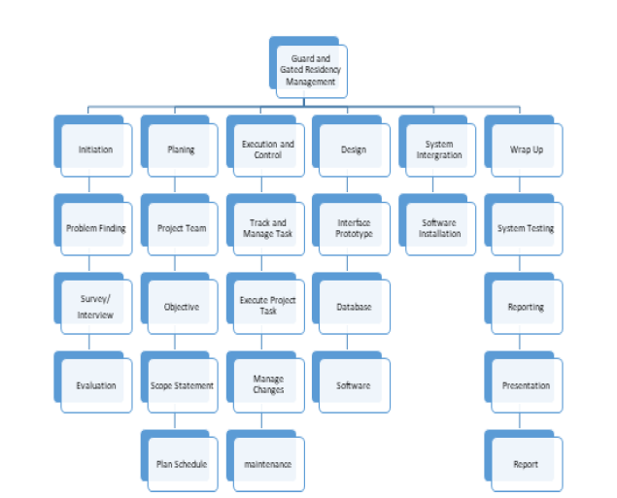
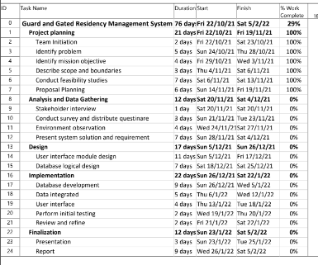
WBS
GANTT CHART
TASK in WBS TALLY WITH TASK IN GANTT CHART

Slide 26
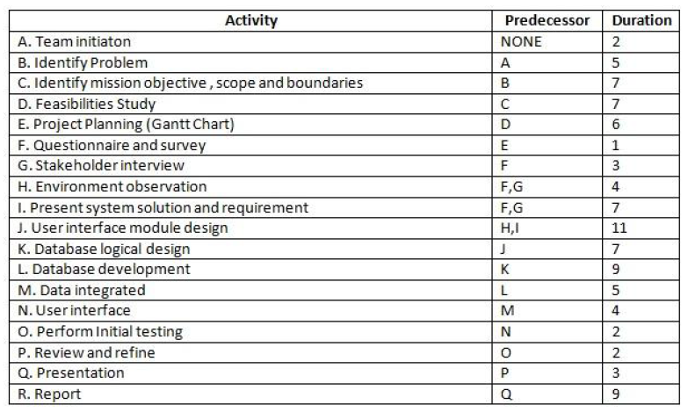
Gantt Chart
PERTCHART
TASK in WBS TALLY WITH TASK IN PERT CHART

Slide 27
PROJECT PLANNING AND CONTROL
Planning includes:
  Selecting a systems analysis team, assign members.
  Estimating time required to complete each task.
  Scheduling the project.
Control means using feedback to monitor project, including:
  Comparing the plan for the project with its actual evolution.
  Taking appropriate action to expedite or reschedule activities.

Slide 28

PROJECT CHARTER
Describes in a written document what the expected results of the systems project are and the time frame for delivery.
Written narrative that clarifies several questions such as:
  What does the user expect of the project?
  What is the scope?
  What analysis methods will be used?
  Who are the key participants?
  What are the project deliverable?

Slide 29


THANK YOU
utmofficial
univteknologimalaysia
utm.my

